Slide 1
Partitioning Data
Chapter 6 – Designing Data‑Intensive Applications
Notes:
INTRO & ROADMAP
Today we tackle Chapter 6 of *Designing Data‑Intensive Applications*—the chapter on partitioning (aka *sharding*). Partitioning is what lets Netflix, Amazon, and your own analytics pipeline scale from one box to thousands while staying fast and reliable.
We’ll move in five acts: first, *why* we partition; second, the two main families—range and hash—using the book’s diagrams; third, how secondary indexes interact with those schemes; fourth, rebalancing and request routing; and finally, hot‑spot detection and mitigation.
Each slide’s notes—like this one—are a full script you can read verbatim. Bold phrases are emphasis cues, not markdown. Feel free to park questions; we have a Q & A slide at the end. Ready? Let’s dive into the motivation for partitioning.

Slide 2
Why Partition?
• Horizontal scalability
• Failure isolation
• Data locality
• Web‑scale foundation
Notes:
WHY PARTITION?
• Scalability: One server maxes out on CPU, RAM, disk IOPS, and network. Slicing the dataset lets us add commodity nodes almost linearly.
• Fault‑Isolation: If a node dies, only its shard is at risk. Replicas elsewhere keep the service alive.
• Data Locality: Queries run where data lives, cutting cross‑rack latency and egress costs.
• Historical Proof: Teradata pioneered the technique in 1983; Google Bigtable and Amazon Dynamo mainstreamed it in the 2000s. Today, every NoSQL and cloud database offers built‑in sharding.
By the end of this talk, you’ll be able to look at any workload and articulate how and where to slice its data so it scales predictably.

Slide 3
Core Terminology
• Partition / shard / tablet
• Partition key
• Hot spot / skew
• Rebalancing
Notes:
CORE TERMINOLOGY
• Partition / Shard / Tablet: The smallest chunk the system can move or fail over.
• Partition Key: The column or tuple that feeds the placement algorithm. Choose poorly, regret forever.
• Hot Spot: A shard whose traffic or size is more than double the cluster median. It drags everyone’s p99 latency down.
• Rebalancing: The live, throttled migration of shards when nodes are added, removed, or overloaded.
These four terms anchor every decision we’ll discuss from this point onward.

Slide 4
Design Dimensions
• Key‑Range ↔ Hash
• Local ↔ Global indexes
• Static ↔ Dynamic buckets
• Routing responsibility
Notes:
FOUR DESIGN DIMENSIONS
1. Key‑Range vs Hash—order versus uniform load.
2. Local vs Global Indexes—cheap writes or cheap reads.
3. Static vs Dynamic Buckets—fixed count or auto split/merge.
4. Routing Patterns—any node forwards, proxy routers, or smart clients.
Keep these dials in mind; we’ll spin each of them in turn.

Slide 5
Key‑Range Partitioning
• Sorted key ranges
• Efficient range scans
• Bigtable, HBase, Spanner
Notes:
RANGE PARTITIONING—STRENGTHS
Think encyclopedia volumes: ‘A–F’ in one book, ‘G–L’ in the next. Range partitioning keeps keys sorted, so time‑window queries touch only the overlapping shards. This model powers Bigtable, HBase, and Spanner, shining on telemetry, logs, and financial ticks where queries often ask for “the last 15 minutes” or “orders for customer 42.”

Slide 6
Range Pitfalls & Fixes
• Sequential hot shard
• Imbalance over time
• Salting or auto‑split
Notes:
RANGE PARTITIONING—WEAKNESSES
Sequential inserts—think auto‑increment IDs or monotonically increasing timestamps—clobber the right‑most shard, creating a write hot spot. Mitigations:
• Key Salting: Random prefix scatters writes. Downside: range queries now need multiple scans.
• Synthetic Keys: Interleave user‑ID or flip timestamp bits to break sequence.
• Automatic Split/Merge: Database monitors size and bisects hot shards automatically.
Each fix trades operational complexity against read or write cost.

Slide 7
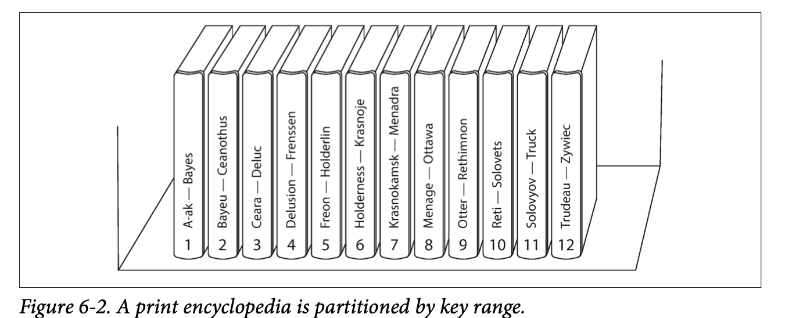
Figure 6‑2 Key‑Range Split
[Insert Figure 6-2]
Notes:
FIGURE 6‑2 WALK‑THROUGH
Guide the audience through the pictur
• Start at the left-hand end. Volume 1 is labelled “A-ak — Bayes.” It owns every entry whose title starts with the letters A or B.
• Move your gaze right. Each succeeding spine—Bayes → Ceanothus, Ceara → Deluc, Delusion → Frenssen, and so on—shows another continuous key range.
• Notice the spines are numbered 1 through 12. That numbering is the partition identifier that software would store in metadata.
• Key insight: the ranges are not evenly sized. Volume 12 has to carry T, U, V, X, Y, Z all by itself, because the book’s editors discovered those letters held fewer articles. Real databases must adapt partition boundaries the same way to keep shards roughly equal in size .
• Conclude by tying back to practice: Bigtable and HBase use identical “alphabet-volume” logic, but the split points are bytes on disk, not paper pages.

Slide 8
Hash Partitioning
• hash(key) ⇒ bucket
• Uniform write load
• Consistent hashing
Notes:
HASH PARTITIONING—STRENGTHS
Hashing feeds keys through a function like Murmur or xxHash, mapping them to a 64‑bit space. Adjacent keys become pseudo‑random numbers, so writes distribute evenly by construction—ideal for social media, chat apps, or sensor firehoses. Consistent hashing further limits data movement when nodes join or leave.

Slide 9
Hash Trade‑offs
• Order lost ⇒ scatter scans
• Higher tail‑latency
• Hybrid hash‑range
Notes:
HASH PARTITIONING—WEAKNESSES
Randomness destroys sort order. A query for “events between 10 :00 and 11 :00” must hit every shard, gather partial results, and merge them, inflating p99 latency and network bytes. Hybrid schemes hash a high‑cardinality prefix (user‑ID) but keep ordering inside the shard to regain range efficiency.

Slide 10
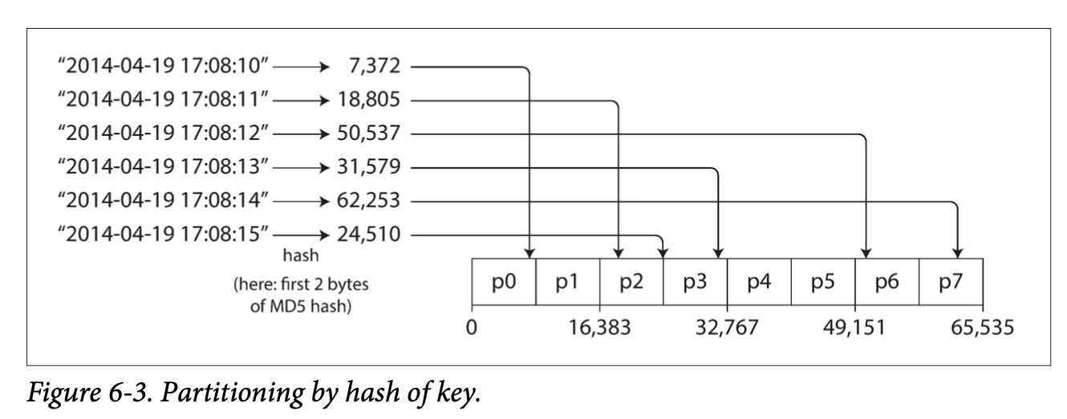
Figure 6‑3 Hash Distribution
[Insert Figure 6-3]
Notes:
FIGURE 6‑3 WALK‑THROUGH
• Begin on the left. Each line is an ISO timestamp—six consecutive seconds on 19 Apr 2014. Notice they’re perfectly ordered.
• Follow the arrows. We run the key through MD5 and take the first two bytes, producing an integer between 0 and 65 535. The examples become 7 372 → 18 805 → 50 537 → 31 579 → 62 253 → 24 510— completely scrambled relative to the original order.
• Shift your eyes to the bar at the bottom. The 0-to-65 535 hash-space is sliced into eight equal chunks: p0 (0-16 383), p1 (16 384-32 767), p2, and so on up to p7 (57 344-65 535).
• Watch the arrows land. 7 372 falls into p0, 18 805 into p1, 50 537 into p3, 31 579 back into p1, 62 253 into p6, 24 510 into p1 again. The key point: adjacent timestamps scatter widely, so no single partition absorbs all the writes.
• Wrap up by stressing that this “blender” effect is why hash partitioning excels at taming hot keys in write-heavy systems.

Slide 11
Local Secondary Indexes
• Index co‑located with data
• Single‑shard writes
• Read fan‑out
Notes:
LOCAL SECONDARY INDEXES
Index lives beside each document shard. Writes update row and index atomically in one place—fast and strongly consistent. Downside: a query like “color = red” must scatter to all shards, collect their slices, and merge. MongoDB’s default index strategy is local for exactly this simplicity.

Slide 12
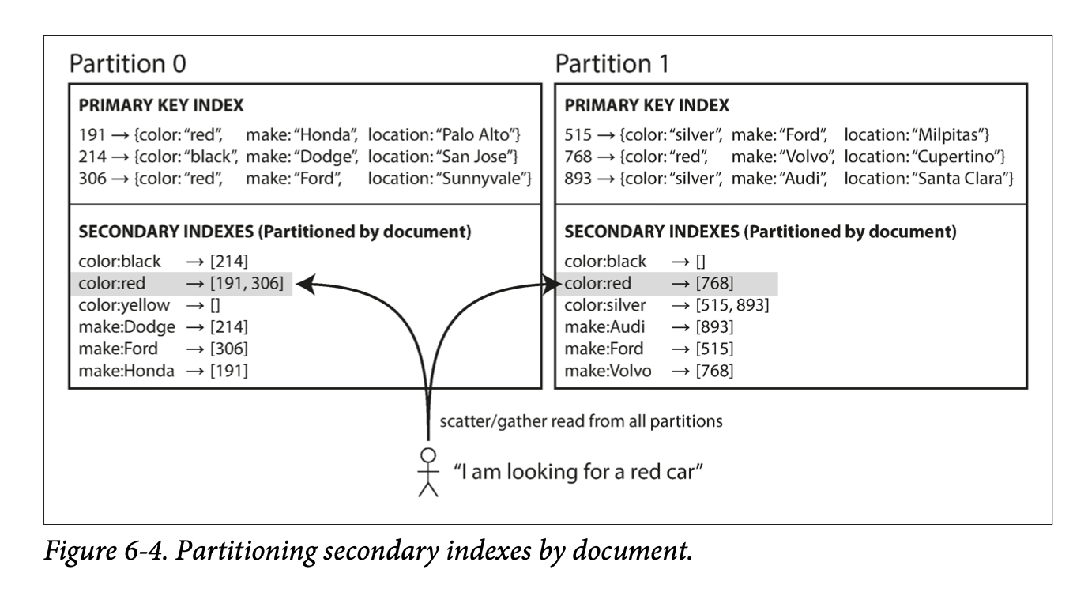
Figure 6‑4 Local Index Fan‑out
[Insert Figure 6-4]
Notes:
FIGURE 6-4 WALK-THROUGH
• Zoom in on the left box—Partition 0. Its primary-key index maps row-id 191, 214, 306 to full car documents. Beneath that, a local secondary index lists color:red → [191, 306]—meaning “red” cars within this partition only.
• Now glance right—Partition 1. Same structure, but here color:red → [768]. Crucially, neither partition knows about the other’s red cars because indexes are co-located with their documents.
• Follow the black arrows. A user at the bottom asks “I’m looking for a red car.”
– The router must scatter the query to every partition.
– Each partition looks up color:red locally and returns its slice of matching IDs—one has two hits, the other one.
– The router then gathers, merges the three IDs, and finally fetches the full documents.
• Highlight the cost. Total latency equals the slowest responding partition plus the merge step. Double your shard count and you double the probability that one shard is busy, illustrating the classic scatter-gather tax of local secondary indexes.

Slide 13
Global Secondary Indexes
• Index partitioned by term
• One‑shard reads
• Multi‑shard writes
Notes:
GLOBAL SECONDARY INDEXES
Here the index itself is partitioned by the indexed term, decoupled from document location. A read for “color = red” lands on exactly one index shard—latency rockets down. Writes, however, now propagate to multiple index shards, often asynchronously, yielding brief eventual consistency. DynamoDB and Spanner both offer global secondary indexes.

Slide 14
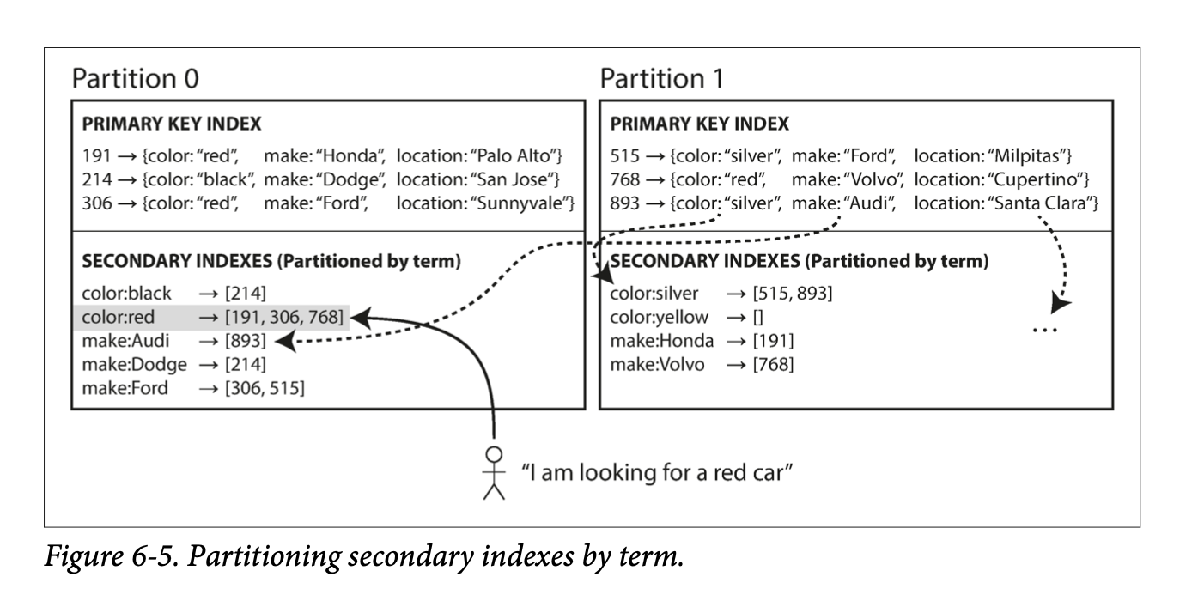
Figure 6‑5 Global Index Layout
[Insert Figure 6-5]
Notes:
FIGURE 6‑5 WALK‑THROUGH
• Start with the user at the bottom. They still say “I’m looking for a red car.” But now look at what the dashed arrows do compared with the last slide.
• Writes first. When a new document arrives in Partition 1 with color:"red" the storage layer pushes the term “red” back to Partition 0, because Partition 0 is the shard that owns that term in the global index. The same happens for other terms—make:"Audi" is routed to yet another shard (dashed arrow on the right).
• Now the read path. The query lands on exactly one shard—the term owner—Partition 0. Its index entry color:red → [191, 306, 768] already aggregates every red-car document regardless of where those documents live. That single lookup returns the three IDs in one hop.
• Highlight the inversion. Compared to the previous slide, we’ve flipped the cost model: reads are cheap and predictable; writes are multi-shard and may involve eventual consistency. This design shines when you have far more reads than writes on secondary attributes.

Slide 15
Rebalancing Strategies
• Virtual nodes
• Dynamic split/merge
• Hash‑ring rescale
Notes:
REBALANCING TECHNIQUES
• Virtual Nodes: Hundreds of tiny hash ranges per machine; new nodes steal slices evenly.
• Dynamic Split/Merge: Range databases split large shards or merge small ones automatically.
• Consistent‑Hash Rescale: Only keys in the moved arc relocate when ring size changes.
Key principle: rebalance must be online and throttled so customers never notice.

Slide 16
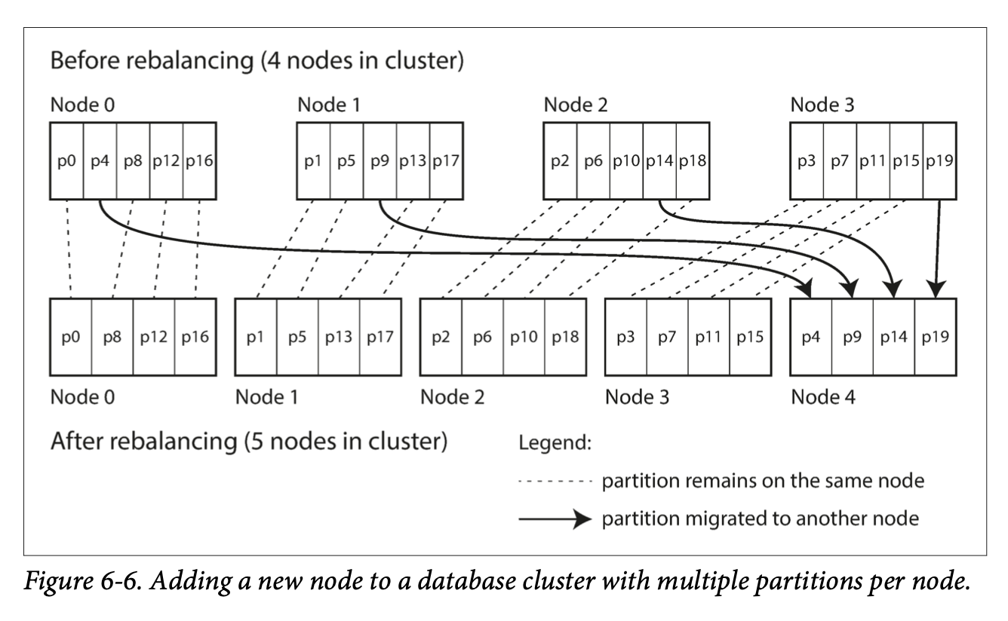
Figure 6‑6 Rebalance Walk‑through
[Insert Figure 6-6]
Notes:
FIGURE 6‑6 WALK‑THROUGH
• Focus on the top row—“Before rebalancing.” We have four physical nodes, each storing five tiny partitions p0-p19. Those mini-partitions are the virtual nodes (vNodes) Cassandra and Dynamo talk about.
• A fifth server joins—Node 4 in the bottom row. Our goal is to give it an even slice of the workload without shuffling the whole dataset.
• Follow the solid black arrows. Only one partition from each existing node—p4, p9, p14, p19—migrates to the newcomer. That’s roughly 20 % of total data, the sweet spot where new capacity appears quickly yet the network isn’t flooded.
• Notice the dashed lines. Every other partition stays put, so the majority of traffic continues unhindered throughout the copy.
• Key moment: once Node 4 finishes copying p4, p9, p14, and p19, ownership flips atomically; clients start routing there automatically.
• Take-away: consistent hashing plus vNodes delivers an online, predictable, and incremental rebalance—no downtime, no multi-hour megacopy

Slide 17
Request‑Routing Patterns
• Any‑node forward
• Proxy routers
• Smart clients
Notes:
REQUEST‑ROUTING PATTERNS
• Any‑Node Forwarding: Client connects anywhere; node forwards internally (Elasticsearch).
• Proxy Routers: Stateless layer holds the map (MongoDB mongos, Vitess).
• Smart Clients: Driver fetches the map and talks straight to leaders (Cassandra, Kafka).
Pick based on latency budget, language ecosystem, and ops overhead.

Slide 18
Hot‑Spot Mitigation
• Per‑shard metrics
• 2× median alert
• Salt / split / cache
Notes:
HOT‑SPOT DETECTION & MITIGATION
Monitor per‑shard metrics—ops/sec, bytes/sec, queue depth, p99 latency. Alert when a shard is ≥ 2× median for 15 minutes. Fixes: key‑salting to break hot keys, on‑demand splits, or a caching tier. Twitter’s “goal” hashtag during the World Cup is the poster child: salting cut write latency from six seconds to 200 ms.

Slide 19
Summary & Takeaways
• Match scheme to workload
• Index locality dial
• Automate rebalance
• Choose key early
Notes:
SUMMARY & TAKEAWAYS
Match partitioning scheme to dominant query pattern. Range wins for ordered analytics; hash for uniform write firehoses. Index locality acts as a cost dial: local indexes favour writes; global indexes favour reads. Automate rebalance and hot‑spot alerts; manual ops won’t scale past ten nodes. Finally, choose the partition key early—changing later is a migration nightmare.

Slide 20
Q & A
• Partition war stories?
• Skew‑detection tools?
• Key design dilemmas?
Notes:
Q & A PROMPT
Time for your questions and war stories. Have you battled a single hot key under Black‑Friday load? Which tools do you trust for shard‑level metrics? Let’s discuss and help each other avoid future 3 a.m. incidents!

